Slide 1
Intro to multithreaded programming with POSIX threads
Main resource: the content and the images are copied from https://hpc-tutorials.llnl.gov/posix/
Notes:
https://courses.engr.illinois.edu/cs241/sp2014/

Slide 2
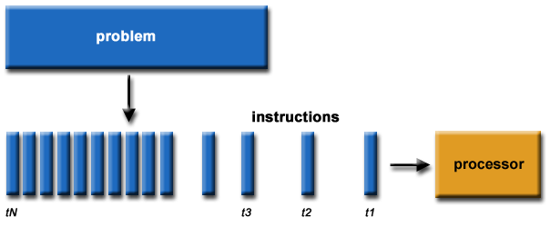
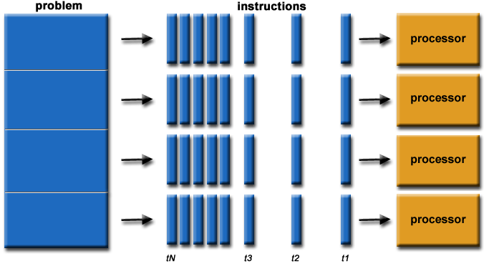
Concurrency & Parallel computing
Operations are concurrent if they can progress independently at the same time
A process is working on multiple tasks at the same time
Parallelism: splitting tasks into subtasks
Parallel computing: running subtasks (concurrent parts) parallel in multiple processor
Serial computing
Parallel computing

Slide 3
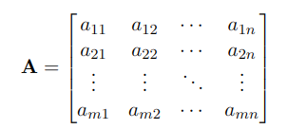
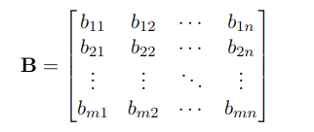
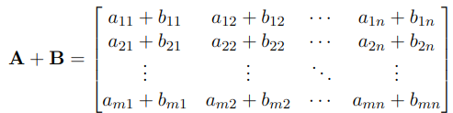
Matrix addition: Concurrent parts?
Data: a_ij, b_ij
Task: Addition
The same task, different data!

Slide 4
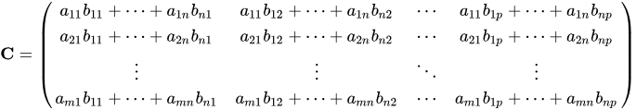
Matrix multiplication: Concurrent parts?
C = AB
Data: a_i, B or A, bj
Task: Multiplication(and addition)
The same task, different data!

Slide 5
What if we want to do both?
Matrix addition
T = A + B
Matrix multiplication
C = AB
Data: A, B
Task: Addition, Multiplication
The same data, different concurrent tasks!

Slide 6
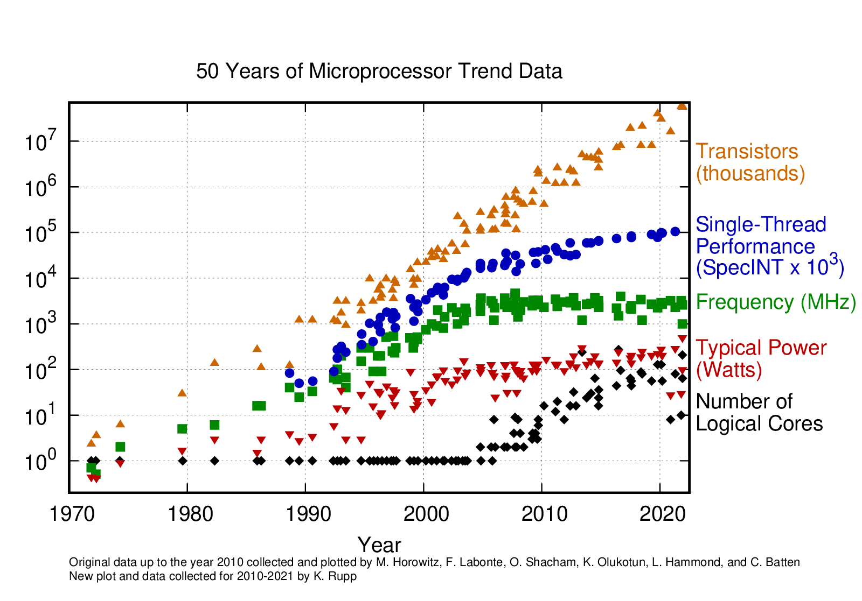
Moore’s law

Slide 7
What is a thread (software thread)?
Like processes, threads allow an application to perform multiple tasks concurrently
A thread is an independent stream of instructions that can be scheduled to run by OS
Threads can be scheduled to use the CPU in any order with any other thread
Threads act concurrently
Threads can be executed in parallel in a multicore system
suspending execution of one thread does not cause the suspension of the other
If the order that threads execute matters, then threads must be synchronized
To the software developer, the concept of a "procedure" that runs independently from its main program

Slide 8
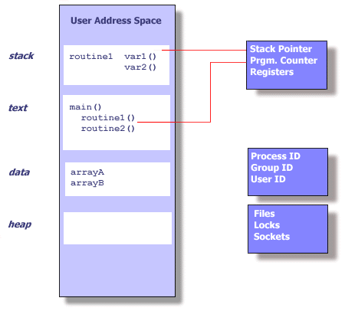
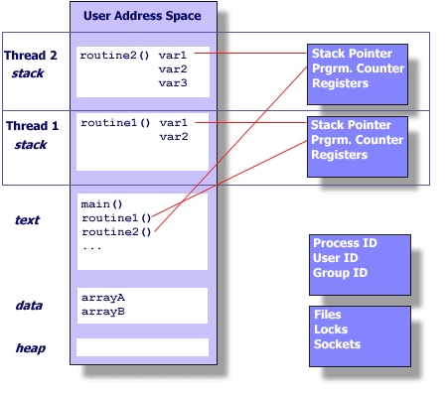
Processes vs Threads
Thread maintains only its own
Stack pointer
Registers
Scheduling properties (such as policy or priority)
Set of pending and blocked signals
Thread specific data.
Process
Each process has its own virtual address space
fork() is expensive

Slide 9
Why threads over processes?
Creating a new process can be expensive
Time
A call into the operating system is needed
Context-switching involves the operating system
Memory
The entire process must be replicated
The cost of inter-process communication and synchronization of shared data
May involve calls into the operating system kernel
Threads can be created without replicating an entire process
Creating a thread is done in user space rather than kernel
Shared virtual address space
communications between two threads is usually faster and easier to implement then communications between two processes.

Slide 10
Timing of 50,000 process/thread creations
Platform | fork() |  |  | pthread_create()
 | real | user | sys | real | user | sys
Intel 2.6 GHz Xeon E5-2670 (16 cores/node) | 8.1 | 0.1 | 2.9 | 0.9 | 0.2 | 0.3
Intel 2.8 GHz Xeon 5660 (12 cores/node) | 4.4 | 0.4 | 4.3 | 0.7 | 0.2 | 0.5
AMD 2.3 GHz Opteron (16 cores/node) | 12.5 | 1.0 | 12.5 | 1.2 | 0.2 | 1.3
AMD 2.4 GHz Opteron (8 cores/node) | 17.6 | 2.2 | 15.7 | 1.4 | 0.3 | 1.3
IBM 4.0 GHz POWER6 (8 cpus/node) | 9.5 | 0.6 | 8.8 | 1.6 | 0.1 | 0.4
IBM 1.9 GHz POWER5 p5-575 (8 cpus/node) | 64.2 | 30.7 | 27.6 | 1.7 | 0.6 | 1.1
IBM 1.5 GHz POWER4 (8 cpus/node) | 104.5 | 48.6 | 47.2 | 2.1 | 1.0 | 1.5
INTEL 2.4 GHz Xeon (2 cpus/node) | 54.9 | 1.5 | 20.8 | 1.6 | 0.7 | 0.9
INTEL 1.4 GHz Itanium2 (4 cpus/node) | 54.5 | 1.1 | 22.2 | 2.0 | 1.2 | 0.6

Slide 11
Problems in threaded programs
Application is less robust; data sharing requires synchronization to avoid race conditions
If a thread misbehaves, it can corrupt data of other threads within same process
If a thread crashes, the entire process crashes

Slide 12
Pthreads API
Historically, hardware vendors have implemented their own proprietary versions of threads.
In order to take full advantage of the capabilities provided by threads, a standardized programming interface was required.
For UNIX systems, a standardized C language threads programming interface has been specified by the IEEE POSIX 1003.1c standard.
Implementations that adhere to this standard are referred to as POSIX threads, or Pthreads.
Most hardware vendors now offer Pthreads in addition to their proprietary API's.

Slide 13
Pthreads are implemented with
a pthread.h header/include file
and a thread library
All identifiers in the threads library begin with pthread_.
Compiler command
gcc -pthread | GNU C
g++ -pthread | GNU C++

Slide 14
The Pthreads API can be informally grouped into four major groups:
(today)Thread management:
Routines that work directly on threads - creating, detaching, joining, etc.
Mutexes: Routines that deal with synchronization, called a "mutex", which is an abbreviation for "mutual exclusion". Mutex functions provide for creating, destroying, locking and unlocking mutexes.
Condition variables: Routines that address communications between threads that share a mutex. Based upon programmer specified conditions.
Synchronization: Routines that manage read/write locks and barriers.

Slide 15
Creating a thread
pthread_create creates a new thread and makes it executable.
This routine can be called any number of times from anywhere within your code. pthread_create arguments:
thread: A unique identifier for the new thread returned by the subroutine.
attr: You can specify a thread attributes object, or NULL for the default values.
start_routine: The new thread starts execution by invoking this function
arg: A single argument that may be passed to start_routine.
It must be passed by reference as a pointer cast of type void.
NULL may be used if no argument is to be passed.
#include <pthread.h>
int pthread_create(pthread_t *thread,
const pthread_attr_t *attr,
void *(*start_routine)(void*),
void *arg);
On success returns 0
On error, it returns error code

Slide 16
Creating a thread
#include <pthread.h>
int pthread_create(pthread_t *thread,
const pthread_attr_t *attr,
void *(*start_routine)(void*),
void *arg);
On success returns 0
On error, it returns error code
/*example*/
pthread_t thread;
int r = pthread_create(&thread, NULL, func, &arg);
if (r != 0)
perror("pthread_create");

Slide 17
Thread termination
The execution of a thread terminates in one of the following ways:
The thread’s start function performs a return specifying a return value for the thread.
return 0;//in func()
The thread calls pthread_exit()
void pthread_exit(void *retval);
Terminates the calling thread
retval specifies the return value of the thread
This value is available to another thread in the same process that calls pthread_join()
retval should point to the heap not to the stack!

Slide 18
Process termination
A multithreaded process terminates when:
one of its threads calls exit();
the main thread (main() function) performs return
it receives a termination signal
all threads have called pthread_exit()
If main() calls pthread_exit() before other threads, the other threads continue to execute

Slide 19
Creating and terminating threads
#include <pthread.h>
#include <stdio.h>
#define NUM_THREADS 5
void *printHello(void *threadid){
long tid;
tid = (long)threadid;
printf("Hello! thread #%ld!\n", tid);
pthread_exit(NULL);
}
int main (int argc, char *argv[]) {
pthread_t threads[NUM_THREADS];
int rc;
long t;
for(t = 0; t < NUM_THREADS; t++) {
printf("In main: creating thread %ld\n", t);
rc = pthread_create(&threads[t], NULL,
printHello, (void *)t);
if (rc) {
printf("ERROR; ret val: %d\n", rc);
exit(-1);
}
}
/* Last thing that main() should do */
pthread_exit(NULL);
}

Slide 20
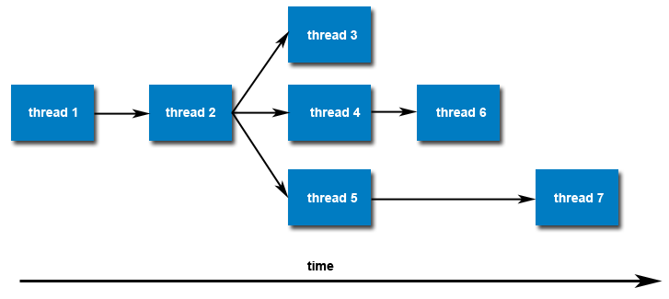
Initially, your main() program comprises a single, default thread. All other threads must be explicitly created by the programmer.
Once created, threads are peers, and may create other threads. There is no implied hierarchy or dependency between threads.

Slide 21
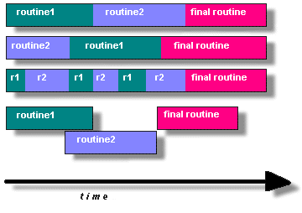
Designing threaded programs
For multi-thread programming
The program must be organized into discrete, independent tasks which can execute concurrently.
For example, if routine1 and routine2 can be interchanged, interleaved and/or overlapped in real time, they are candidates for threading.

Slide 22
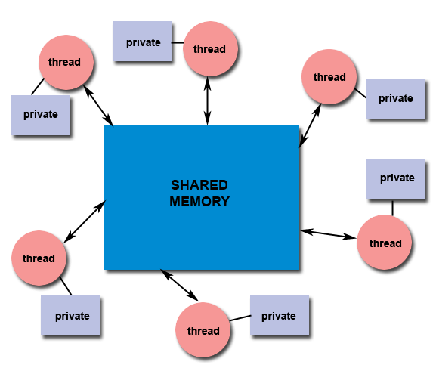
Shared memory model
All threads have access to the same global, shared memory
Threads also have their own private data
Programmers are responsible for synchronizing access (protecting) globally shared data.

Slide 23
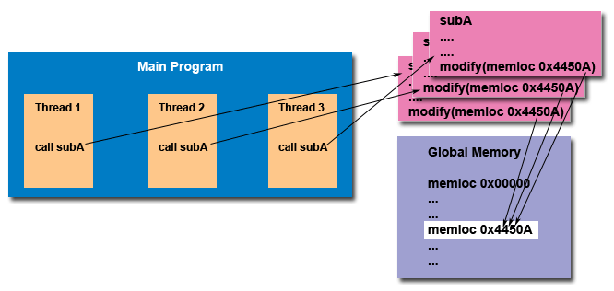
Thread safeness
an application’s ability to execute multiple threads simultaneously without “clobbering” shared data or creating “race” conditions

Slide 24
Passing arguments to threads
int taskids[NUM_THREADS];
for(t=0; t<NUM_THREADS; t++){
taskids[t] = t;
printf("Creating thread %ld\n", t);
rc = pthread_create(&threads[t], NULL,printHello, (void*)&taskids[t]);
...
}

Slide 25
Passing multiple arguments
struct thread_data thread_data_array[NUM_THREADS];
void *printHello(void *threadarg) {
struct thread_data *my_data;
...
my_data = (struct thread_data *) threadarg;
taskid = my_data->thread_id;
sum = my_data->sum;
hello_msg = my_data->message;
...
}
int main (int argc, char *argv[]) {
...
thread_data_array[t].thread_id = t;
thread_data_array[t].sum = sum;
thread_data_array[t].message = messages[t];
rc = pthread_create(&threads[t], NULL,
printHello,
(void *) &thread_data_array[t]);
...
}

Slide 26
What is wrong with this code?
int rc;
int t;
for(t=0; t<NUM_THREADS; t++) {
printf("Creating thread %ld\n", t);
rc = pthread_create(&threads[t], NULL, printHello, (void *) &t);
...
}
Argument passing incorrect: It passes the address of variable t, which is shared memory space and visible to all threads. As the loop iterates, the value of this memory location changes, possibly before the created threads can access it.

Slide 27
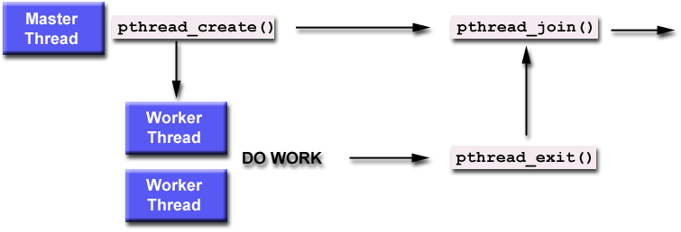
Joining threads (similar to “waitpid”)
Any thread in a process can use pthread_join() to join with any other thread in the process (there is no hierarchy).
"Joining" is one way to accomplish synchronization between threads.
#include <pthread.h>
int pthread_join(pthread_t threadid,
void **retval);
The pthread_join() subroutine blocks the calling thread until the specified threadid thread terminates.
If retval is not NULL, it points to a copy of terminated thread’s return value or the value specified in pthread_exit().

Slide 28
Detaching Threads
By default, a thread is joinable
when it terminates, another thread can obtain its return status using pthread_join()
If we don’t care about return value and want the system to cleanup the resources on termination, we mark thread as detached.
Once the thread is detached, it is no longer possible to use pthread_join() to obtain its status
int pthread_detach(pthread_t thread);
thread:target thread id
Thread resources can be reclaimed on termination
Returns 0 on success error code on failure
this will explicitly detach a thread even though it is created as joinable.

Slide 29
Miscellaneous Routines
pthread_t pthread_self(void);
returns the thread ID of the calling thread.
int pthread_equal(pthread_t t1, pthread_t t2);
compares the thread IDs t1 and t2.
returns a non-zero value if t1 and t2 are equal; otherwise, zero shall be returned.

Slide 30
Threads-summary
Exists within a process and uses the process resources
Has its own independent flow of control as long as its parent-process exists and the OS supports it
Duplicates only the essential resources it needs to be independently schedulable
May share the process resources with other threads that act equally independently (and dependently)
Dies if the parent process dies - or something similar
Is "lightweight" because most of the overhead has already been accomplished through the creation of its process
Because threads within the same process share resources:
Changes made by one thread to shared system resources (such as closing a file) will be seen by all other threads.
Two pointers having the same value point to the same data.
Reading and writing to the same memory locations is possible, and therefore requires explicit synchronization by the programmer.

